Slide 1

Coding
Robotics
Games and Apps Development
TEACHABLE MACHINE WITH GOOGLE (VOICE RECOGNITION PROJECT)
MACHINE LEARNING
…Nurturing STEM Skills for the future
www.brainiacs.com.ng
Learn, Play, Innovate

Slide 2

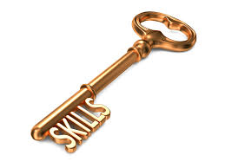
Key Skills to Learn
Creativity.
Critical Thinking.
Problem solving.
Communication
Digital Literacy
Collaboration
www.brainiacs.com.ng
Learn, Play, Innovate

Slide 3
Learning Objectives
At the end of the lesson the pupils should be able to:
Explore the concept of Voice Recognition.
Use Teachable Machine to Train a Voice Recognition Model.
Test and Evaluate the Model’s performance.
Export the Train Model.
www.brainiacs.com.ng
Learn, Play, Innovate

Slide 4
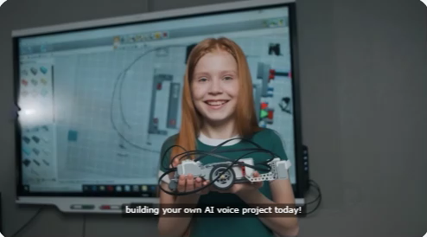
Wow Factor
www.brainiacs.com.ng
Learn, Play, Innovate

Slide 5
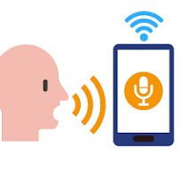
What is Voice Recognition?
Voice recognition, also known as speech recognition, is a technology that enables a machine or computer to understand, process, and respond to human speech. It allows devices to convert spoken words into text or commands, making interactions between humans and computers more natural.
www.brainiacs.com.ng
2
Learn, Play, Innovate

Slide 6
How does Voice Recognition Work?
Voice recognition works as listed in the steps below;
Step 1: It captures the sound.
Step 2: Moves on to process the sound.
Step 3: Breaks down the sound into small units called phonemes.
Step 4: Match the sound to known words.
Step 5: Then finally, understands send out the output.
www.brainiacs.com.ng
2
Learn, Play, Innovate

Slide 7
Application of Voice Recognition in Everyday Life
Voice Recognition has several real-world application and could be found in the following areas below;
Virtual Assistants – Siri, Google Assistant, Alexa, and Cortana respond to voice commands
Voice-to-Text – Dictation apps convert speech into written text.
Smart Homes – Voice-controlled devices like lights and thermostats.
Security & Authentication – Some systems use voice as a biometric for identity verification.
Customer Service Bots – Automated call centers that understand and process voice commands
www.brainiacs.com.ng
Learn, Play, Innovate

Slide 8
Training a Voice Recognition Model using Google Teachable Machine
To train a voice recognition model using google teachable machine the following steps must be taken into consideration;
Collect and record different voice samples for training.
Label and classify different sounds or words.
Train the model to recognize voice commands
www.brainiacs.com.ng
Learn, Play, Innovate

Slide 9
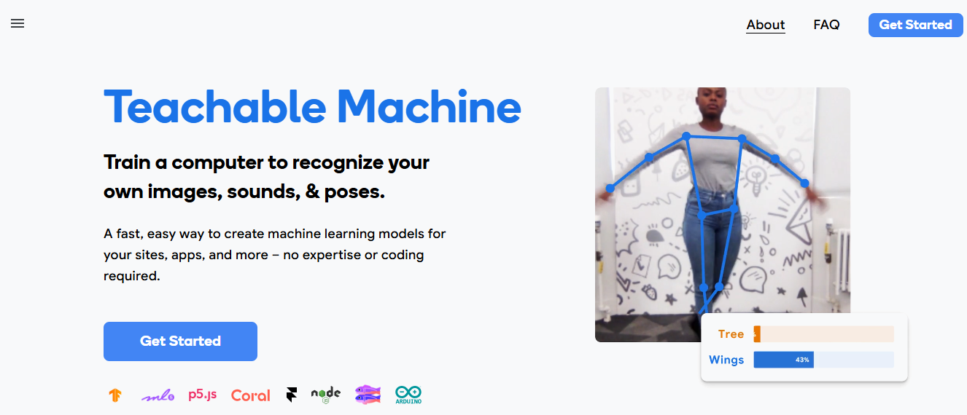
Steps to Train a Voice Recognition Model on Google Teachable Machine
STEP 1: Open the Google Teachable Machine platform by clicking on the link below:
https://teachablemachine.withgoogle.com/
STEP 2: Click on ‘Get Started’
www.brainiacs.com.ng
Learn, Play, Innovate

Slide 10
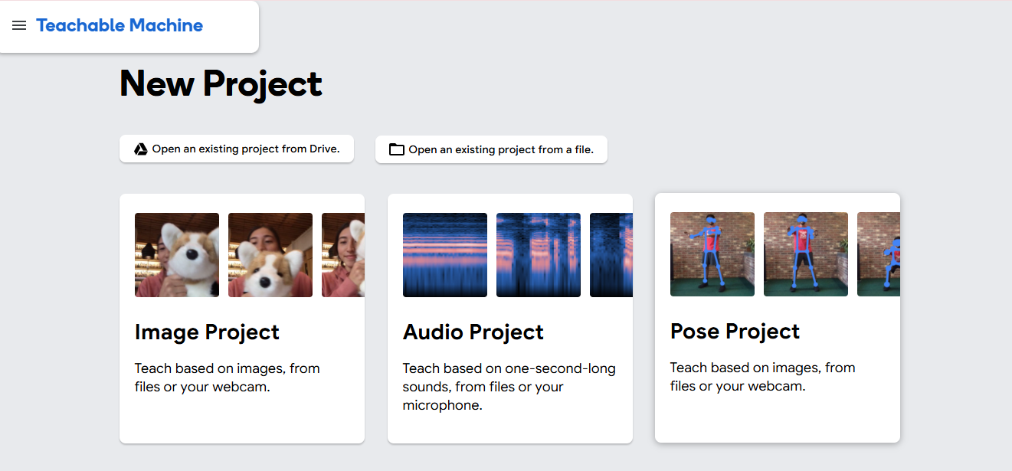
Steps to Train a Voice Recognition Model on Google Teachable Machine
STEP 3: Click on Audio Project
www.brainiacs.com.ng
Learn, Play, Innovate

Slide 11
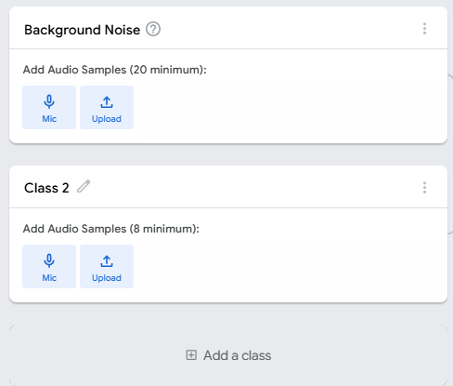
Steps to Train a Voice Recognition Model on Google Teachable Machine
STEP 4: Click here to rename it to desirable voice command but for the purpose of the is project rename it as HELLO
STEP 5: Click here to Add another class and rename it as HI
www.brainiacs.com.ng
Learn, Play, Innovate

Slide 12
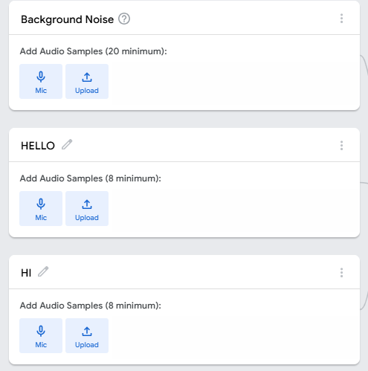
Steps to Train a Voice Recognition Model on Google Teachable Machine
STEP 6: Click on the Mic to record the BACKGROUND NOISE for at least 20 seconds and extract it
STEP 7: Click here to record your HELLO voice note and extract at least eight (8) samples
STEP 8: Repeat STEP 7 here too but this time record your HI voice note
www.brainiacs.com.ng
Learn, Play, Innovate

Slide 13
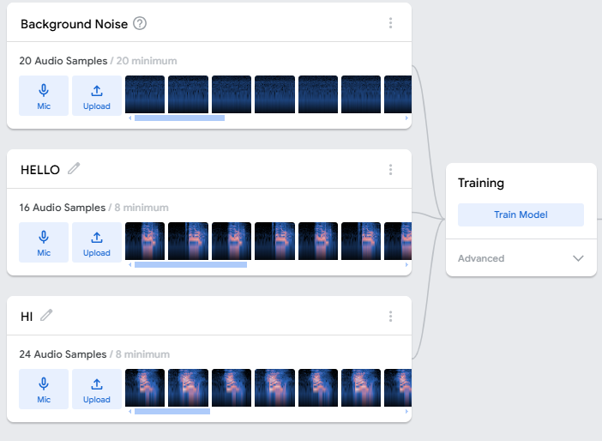
Steps to Train a Voice Recognition Model on Google Teachable Machine
STEP 9: Proceed to click here to train your model and remember not to switch your computer tabs while training your model.
www.brainiacs.com.ng
Learn, Play, Innovate

Slide 14
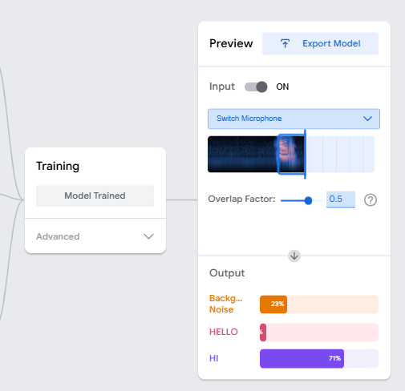
Steps to Train a Voice Recognition Model on Google Teachable Machine
STEP 7: After successfully training your voice recognition model, move close to your mic and say HELLO or HI and observe the accuracy of the output
www.brainiacs.com.ng
Learn, Play, Innovate

Slide 15
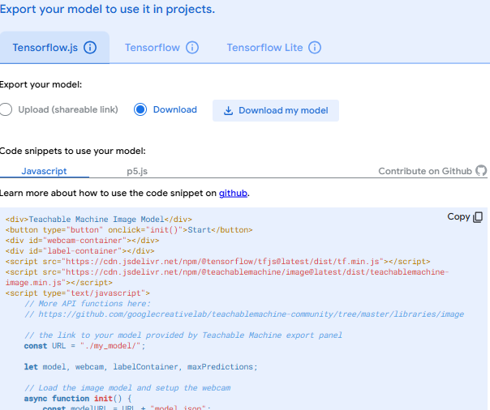

Exporting a Voice Recognition Model on Google Teachable Machine
STEP 5: Click here to finally download your model for future use
STEP 1: Upon being satisfied with your model output click here to export your model
www.brainiacs.com.ng
Learn, Play, Innovate

Slide 16

Lesson Outcomes
Learners can,
List examples of voice recognition in everyday life.
Successfully collect and record different voice samples.
Label and classify recorded voice data in Teachable Machine.
Train a simple voice recognition model to identify specific sound.
Input new voice samples to test model accuracy.
www.brainiacs.com.ng
Learn, Play, Innovate

Slide 17
End of Lesson
17
www.brainiacs.com.ng
Learn, Play, Innovate
Notes:
Sing we are Brainiacs while engaging the children

Slide 18
How you can get to us
18
Twitter: Brainiacs_Ng
Phone No: +234 909 109 5057
Email: brainiacsng@gmail.com
info@brainiacs.com.ng
Website: www.brainiacs.com.ng
google+: brainiacsng
Youtube Channel: Brainiacs_Ng
www.brainiacs.com.ng
Learn, Play, Innovate

Slide 19

19
Well-done!
www.brainiacs.com.ng
Learn, Play, Innovate

